Slide 1
Ck branch group
Marketing expertise to increase your census

Slide 2
Agenda
What we do
How we do it
Sample deliverables
Invoice

Slide 3
What…
Professional Services
Treatment operations consulting
Website content design
Call lead generation
Recording, QA/QC
SEO Branding
Traffic reporting/analytics
Admissions coaching

Slide 4
How…
unique web media platform
Immediate visitor activity to your website
Strengthen SEO brand awareness by retargeting visitors
Practically no competition for ad space with other treatment centers
Keep marketing costs low and consistent
Provide Unbranded content (ie: Vivitrol, Outpatient Detox, Psych Meds)
Geographic targeting capability
No expensive PPC or Google Media Ads

Slide 6
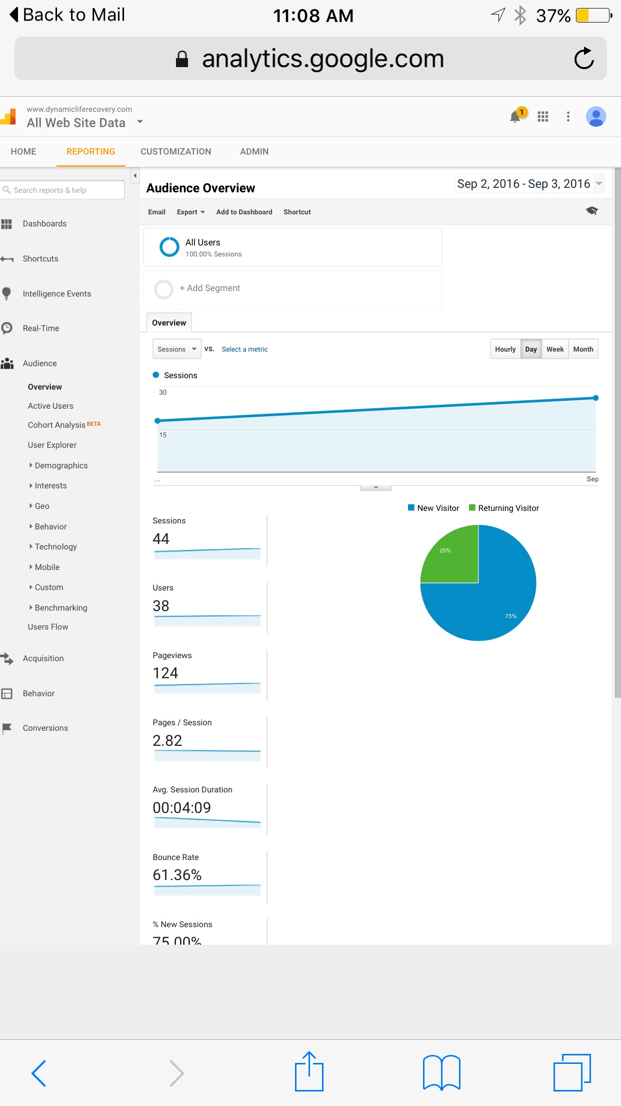
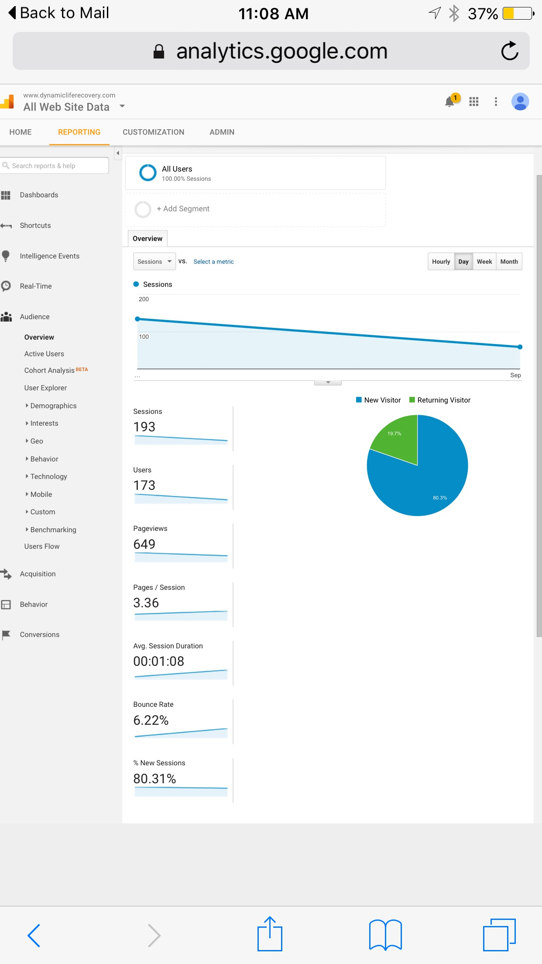
Web consulting

Slide 7
Price sheet
$50 per call - over 250 raw calls
$55 per call - over 150 raw calls
$65 per call - under 150 raw calls

Slide 8
Contact us for a free assessment
Christine Klespies
ckbranchgroup@gmail.com
Cell: 561-302-6765
Twitter/Skype: CKBranch
241 SE 24th Ave
Boynton Beach Fl.
33435

